Slide 1

Mi Beard trimmer
Presenters Name:
ROHAAN NADEEM (102)
MASHOOD UR REHMAN (030)
H. HASEEB (009)
This Photo by Unknown Author is licensed under CC BY-ND

Slide 2


Mi Beard trimmer
Topic one: Introduction to Company.
Topic two: Introduction to Product.
Topic three: Precautions to adopt.

Slide 3

Xiaomi
Xiaomi Inc. better known as "MI" is a privately owned Chinese electronics company headquatered in Beijing, China.
Began its operation in August 2010 with Android based firmware MIUI.
The company's founder and CEO is Lei Jun, when he was 40 years old, along with six senior associates.
This Photo by Unknown Author is licensed under CC BY-NC-ND

Slide 4




Marketing Strategy:
Apple makes its profit on hardware
while Xiamoi makes their profit on services.
don’t compromise on the component quality and performance.
Company does not own a single physical store.
Company takes customer feedbacks to keep improving.

Slide 5
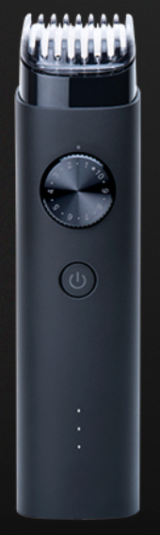

Mi Beard Trimmer
This trimmer is of Xiamoi Brand. Let’s explore the art of grooming and how this trimmer can help you achieve the perfect look. Before we dive into the grooming techniques

Slide 6
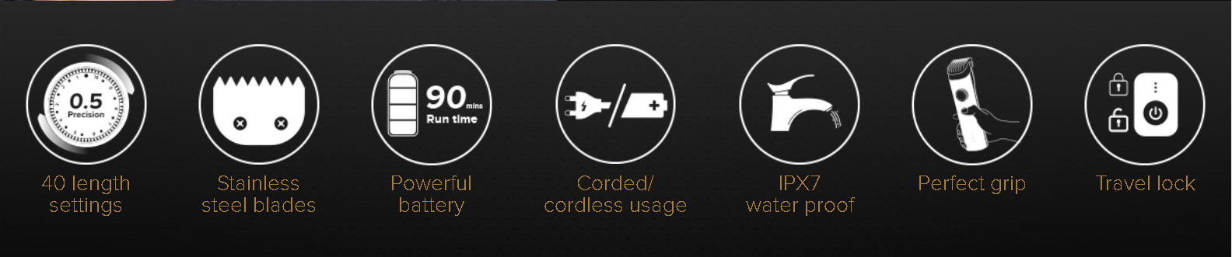
Mi Beard Trimmer

Slide 7
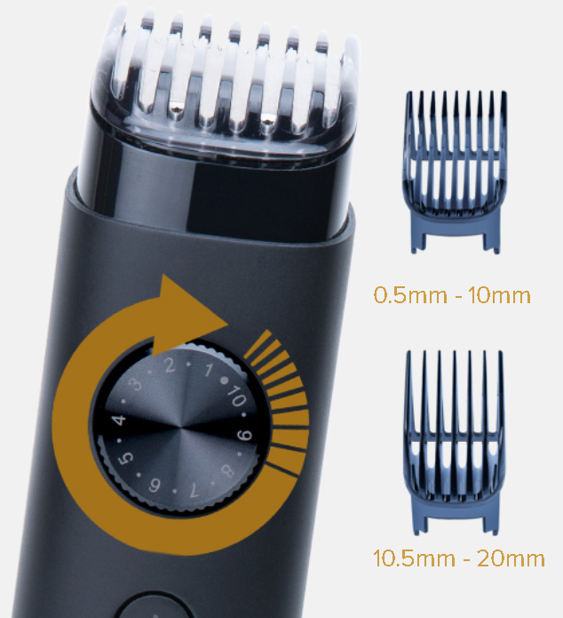

Conquer every style 40 length settings with 0.5mm precision
With 2 combs that can go
between 0.5mm and 20mm, this trimmer will perfectly sculpt your beard. Precision is at its
finest with 6000 oscillations per min delivering accurate cuts
and even shape.

Slide 8

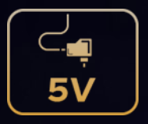
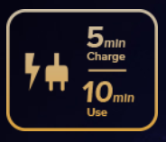

Ultra-powerful battery
Charging time: 2 hrs Run time: 90 mins
Supports
5V adapter
Charges quickly
for instant use
LED battery indicator

Slide 9
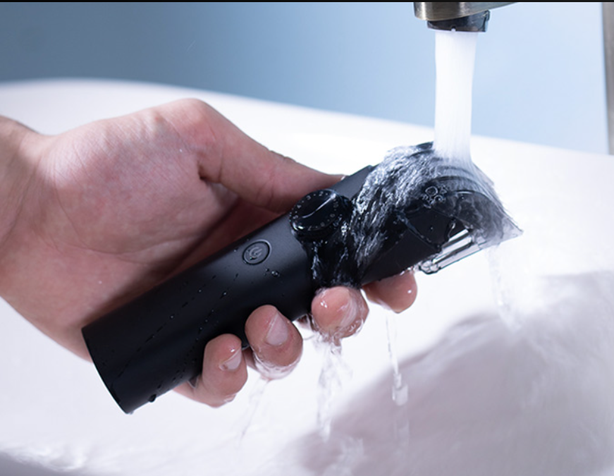
Clean it in no time IPX7 fully-washable body
The whole body is hydro-resistant and fully washable for your convenience. Comes with detachable head.

Slide 10
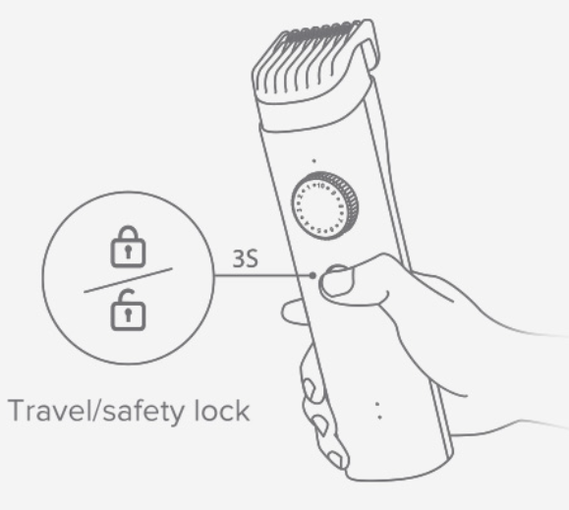
Travel ready Comes with travel pouch
Travel safe as the travel lock function keeps the trimmer from switching on unintentionally. Store it in the travel pouch to prevent undue damage.

Slide 11
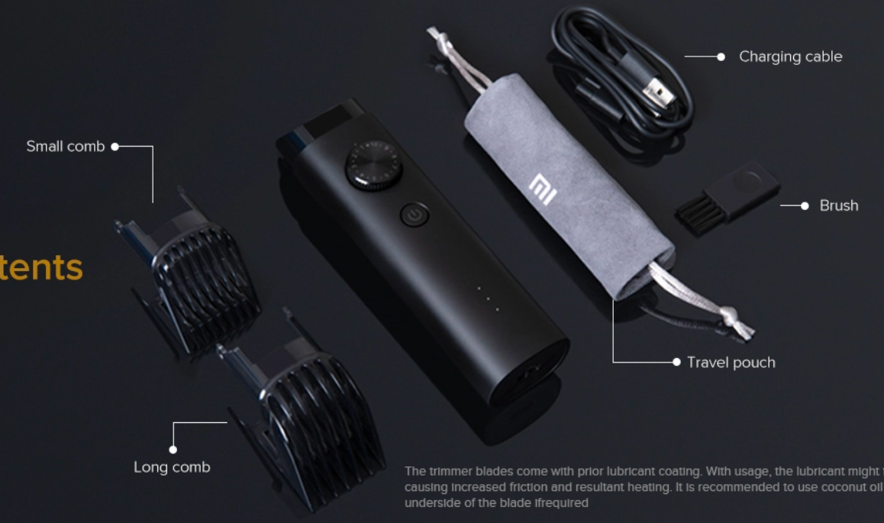


Box content

Slide 12
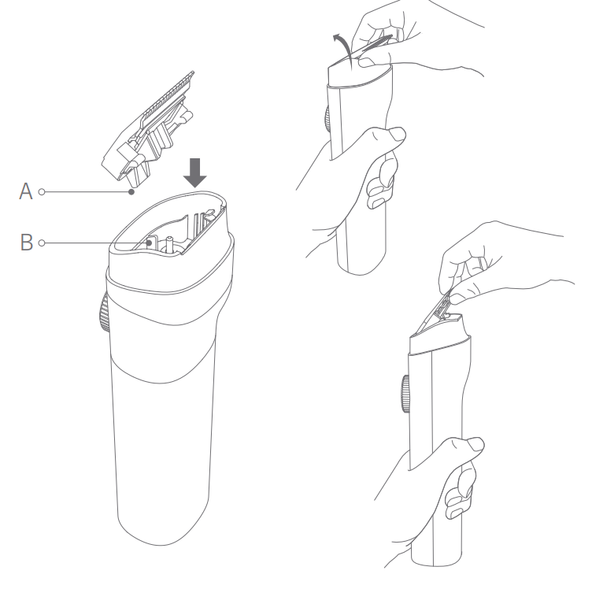
Precautions
Blade head needs to be correctly installed before use.
Make sure trimmer charging pin are completely dry before connecting cable.
To prevent injuries don’t press blade teeth into skin.
Charge trimmer for long once a six month if it is not used for a long time.
Only install, remove and plug the trimming comb and blade head while it is off.
Turn the trimming comb to the lowest position and enable the travel lock when transporting the trimmer.

Slide 13
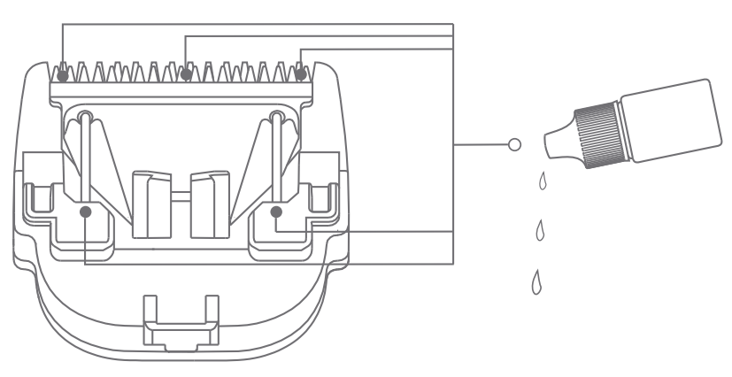

Care & maintenance
Before cleaning the trimmer, make sure it is turned off and not being charged.
Remove the trimming comb and blade head and use the provided cleaning brush to clean out the blade head slot and blade teeth.
Water on or near the charging port should be dried before storing the device.
It’s normal for the blade to get warmer during use.
Add the included blade oil onto the five points illustrated below, to keep the blade running normally.

Slide 14




4c’s of Communication In User Manual
Completeness
Clarity
Concreteness
Concise

Slide 15

Thank you
Any Questions?

